Slide 1
Bayes Nets
1

Slide 2
CSP
Focus on finding a solution that satisfies all imposed constraints
Used in applications like scheduling tasks, solving Sudoku puzzles, and cryptography
Key concepts:
    Variables
    Domains
    Constraints
    Medical Diagnosis ??

Slide 3
Solution
Uncertainty and Probabilities: Medical diagnoses often involve uncertainty. A patient might present with various symptoms that could point to several different diseases. CSPs struggle with inherent uncertainty and don't handle probabilities well.
Complex Relationships: Medical conditions often have intricate relationships between symptoms, medical history, and test results.
  CSPs work best with well-defined constraints, and modeling these complex relationships can be challenging.

Slide 4
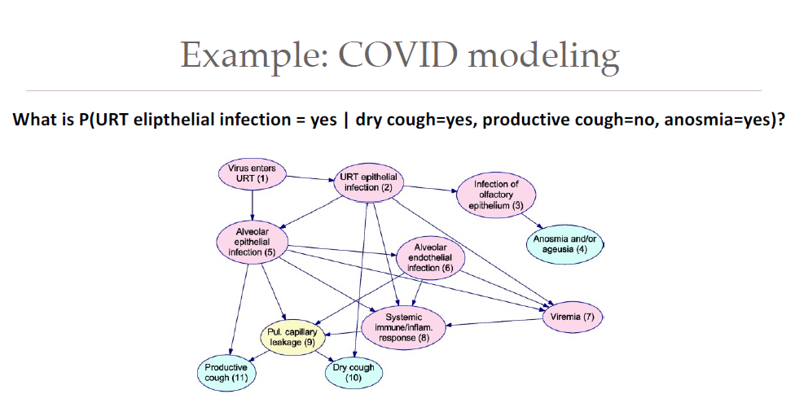
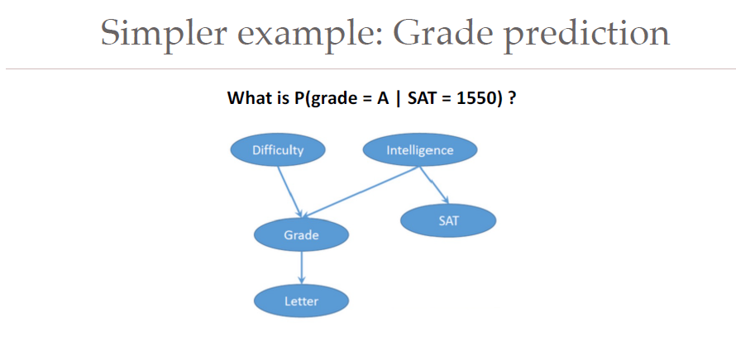

Slide 5
Bayes nets
A Bayes net (Bayesian network) is a way to model relationships
between various variables.
Goal is to obtain some marginal or conditional distributions
e.g., P(infected) or P(infected | cough)

Slide 6
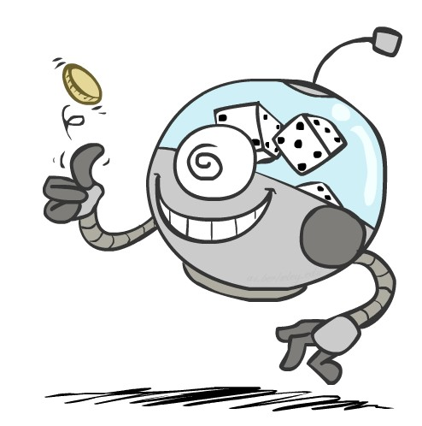
Random Variables
A random variable is some aspect of the world about
which we (may) have uncertainty
  R = Is it raining?
  T = Is it hot or cold?
  D = How long will it take to drive to work?
  L = Where is the ghost?
We denote random variables with capital letters
Random variables have domains
R in {true, false}
T in {hot, cold}
▪ D in [0, ∞)
L in possible locations, maybe {(0,0), (0,1), …}
(often write as {+r, -r})
7

Slide 7
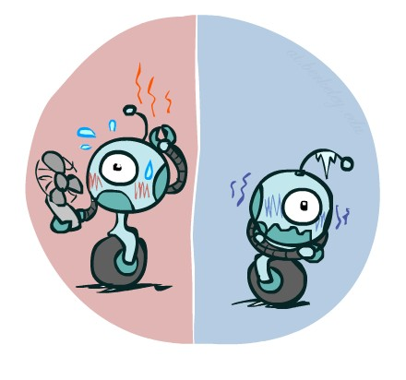

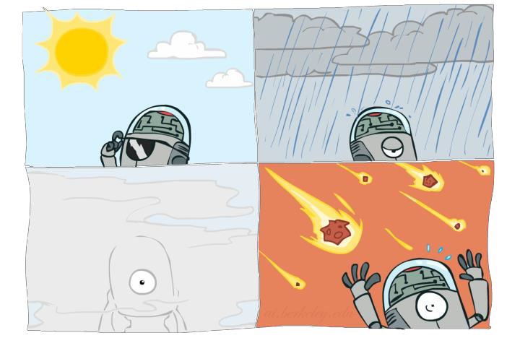

Probability Distributions
Associate a probability with each outcome
  Temperature:
Weather:
W | P
sun | 0.6
rain | 0.1
fog | 0.3
meteor | 0.0
T | P
hot | 0.5
cold | 0.5
8

Slide 8


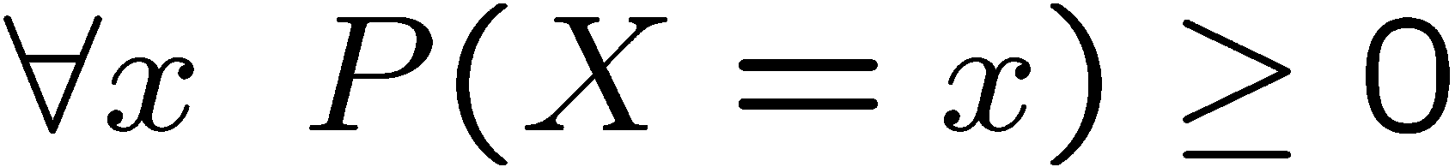
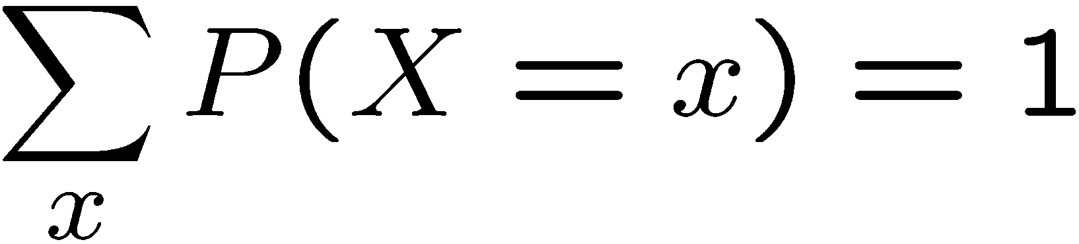
Probability Distributions
Unobserved random variables have distributions
Shorthand notation:
OK if all domain entries are unique
T | P
hot | 0.5
cold | 0.5
W | P
sun | 0.6
rain | 0.1
fog | 0.3
meteor | 0.0
A distribution is a TABLE of probabilities of values
A probability (lower case value) is a single number
Must have:
and
9

Slide 9




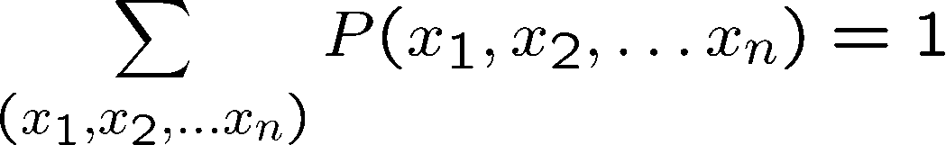
Joint Distributions
A joint distribution describes the probability of two or more random variables occurring together.
A joint distribution over a set of random variables: specifies a real number for each assignment (or outcome):
T | W | P
hot | sun | 0.4
hot | rain | 0.1
cold | sun | 0.2
cold | rain | 0.3
Must obey:
10

Slide 10
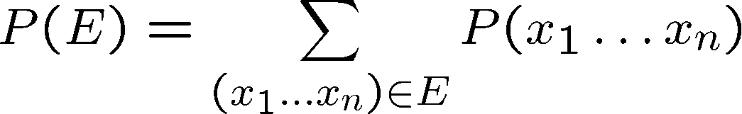
Events
An event is a set E of outcomes
T | W | P
hot | sun | 0.4
hot | rain | 0.1
cold | sun | 0.2
cold | rain | 0.3
From a joint distribution, we can calculate the probability of any event
  Probability that it’s hot AND sunny?
  Probability that it’s hot?
  Probability that it’s hot OR sunny?
11

Slide 11
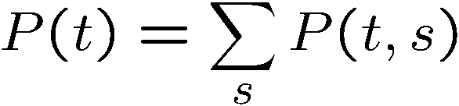
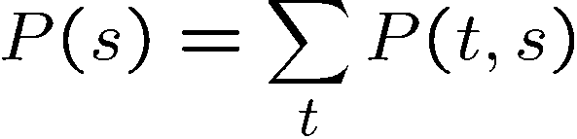
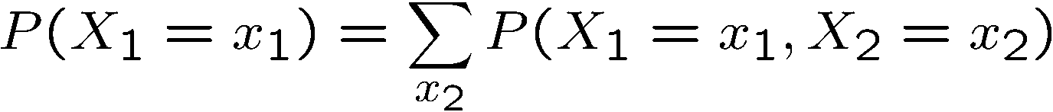
Marginal Distributions
• Marginalization is summing out a subset of random variables from a joint distribution to obtain a distribution of the remaining subset.
• The marginal probability of an event is the probability of that event happening, regardless of the other event.
  • picking a red ball followed by a blue ball from a basket containing both red and blue balls.
  calculates the probability of selecting red balls independently of subsequent picks
T | P
hot | 0.5
cold | 0.5
T | W | P
hot | sun | 0.4
hot | rain | 0.1
cold | sun | 0.2
cold | rain | 0.3
W | P
sun | 0.6
rain | 0.4

Slide 12
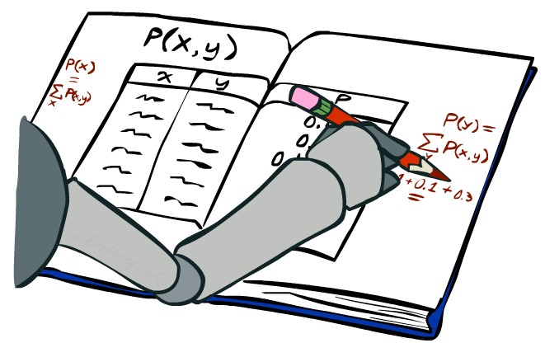
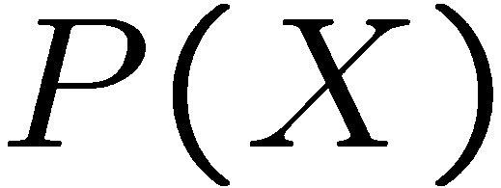
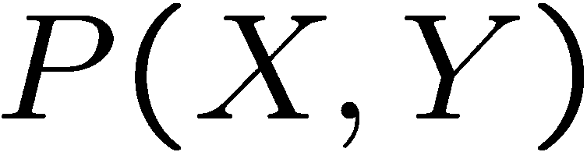
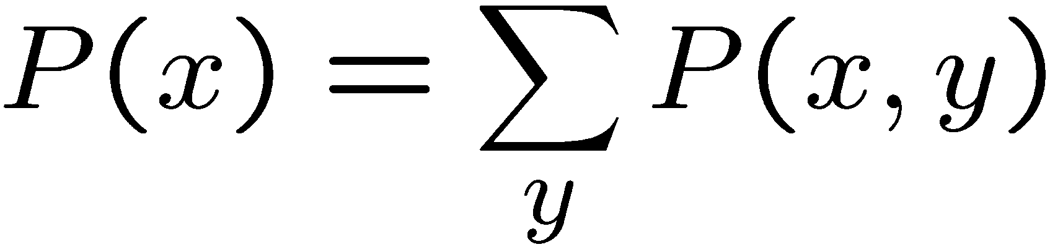
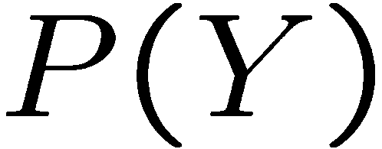
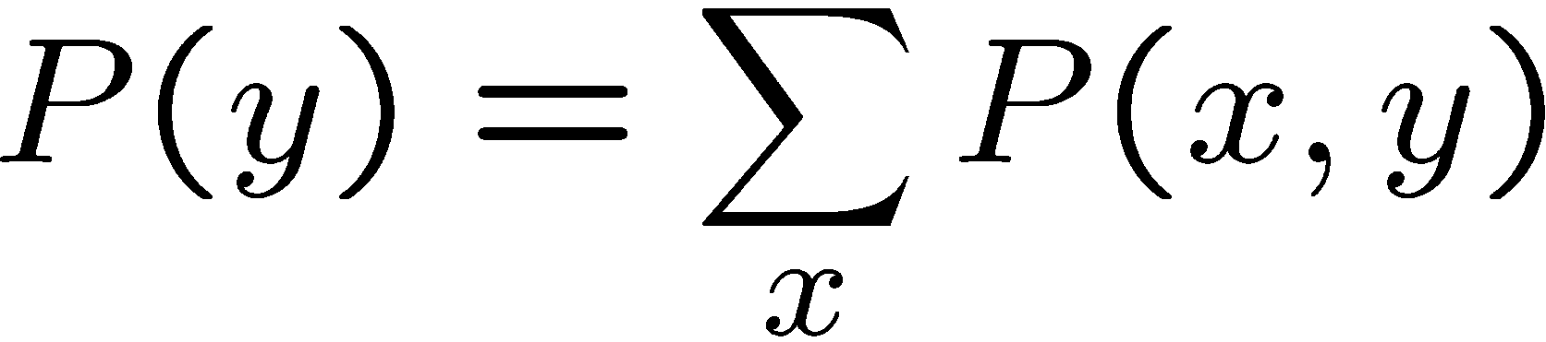
Marginal Distributions
X | P
+x
-x
X | Y | P
+x | +y | 0.2
+x | -y | 0.3
-x | +y | 0.4
-x | -y | 0.1
Y | P
+y
-y

Slide 13
Quiz: Marginal Distributions
X | P
+x | .5
-x | .5
X | Y | P
+x | +y | 0.2
+x | -y | 0.3
-x | +y | 0.4
-x | -y | 0.1
Y | P
+y | .6
-y | .4

Slide 14
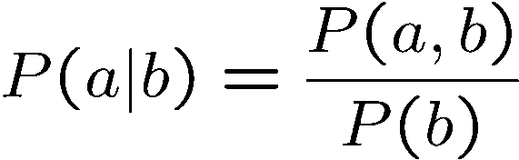
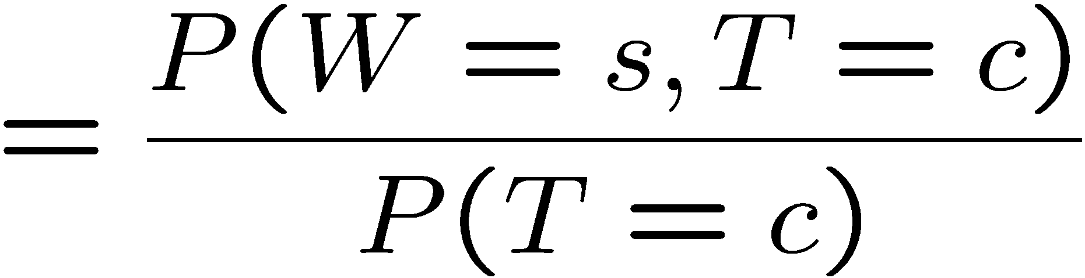
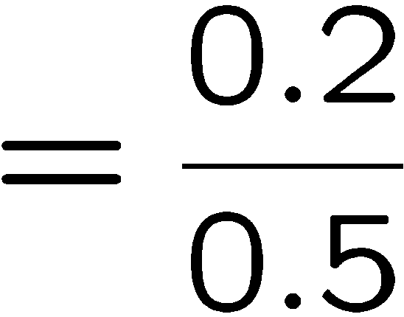
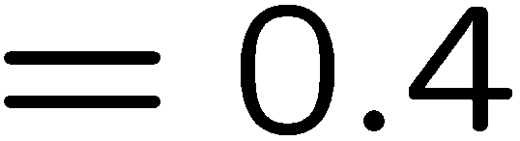

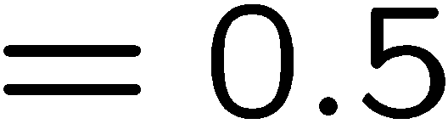
Conditional Probabilities
A simple relation between joint and conditional probabilities
  In fact, this is taken as the definition of a conditional probability
P(a,b)
P(a)
P(b)
T | W | P
hot | sun | 0.4
hot | rain | 0.1
cold | sun | 0.2
cold | rain | 0.3
Marginal

Slide 15
Quiz: Conditional Probabilities
▪ P(+x | +y) ?
X | Y | P
+x | +y | 0.2
+x | -y | 0.3
-x | +y | 0.4
-x | -y | 0.1
▪ P(-x | +y) ?
▪ P(-y | +x) ?

Slide 16
Conditional Probabilities
▪ P(+x | +y) ?
.2/.6=1/3
X | Y | P
+x | +y | 0.2
+x | -y | 0.3
-x | +y | 0.4
-x | -y | 0.1
▪ P(-x | +y) ?
.4/.6=2/3
▪ P(-y | +x) ?
.3/.5=.6

Slide 17



Conditional Distributions
Conditional distributions are probability distributions over
some variables given fixed values of others
Conditional Distributions
Joint Distribution
W | P
sun
rain
T | W | P
hot | sun | 0.4
hot | rain | 0.1
cold | sun | 0.2
cold | rain | 0.3
W | P
sun
rain

Slide 18
Conditional Distributions
Conditional distributions are probability distributions over
some variables given fixed values of others
Conditional Distributions
Joint Distribution
W | P
sun | 0.8
rain | 0.2
T | W | P
hot | sun | 0.4
hot | rain | 0.1
cold | sun | 0.2
cold | rain | 0.3
W | P
sun | 0.4
rain | 0.6

Slide 19
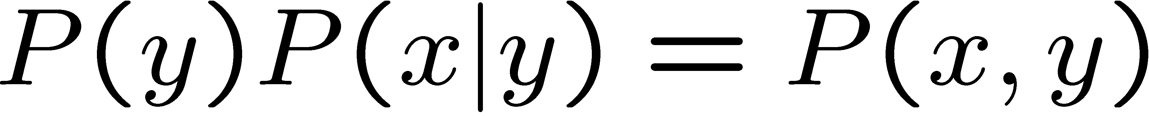
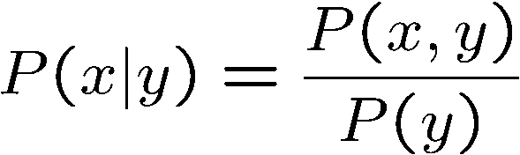
The Product Rule
Sometimes have conditional distributions but want the joint

Slide 20


The Product Rule
Example:
D | W | P
wet | sun | 0.1
dry | sun | 0.9
wet | rain | 0.7
dry | rain | 0.3
D | W | P
wet | sun
dry | sun
wet | rain
dry | rain
R | P
sun | 0.8
rain | 0.2
0.08
0.72
0.14
0.06

Slide 21
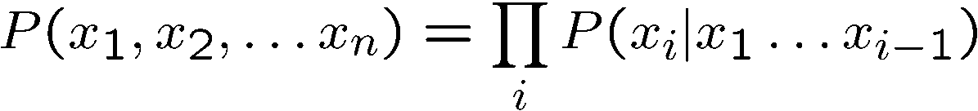
The Chain Rule
More generally, can always write any joint distribution as an
incremental product of conditional distributions

Slide 22
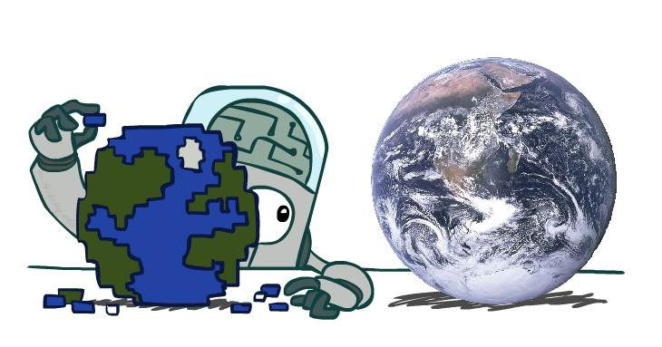
Probabilistic Models
Models describe how (a portion of) the world works
Models are always simplifications
  May not account for every variable
  May not account for all interactions between variables
  “All models are wrong; but some are useful.”
– George E. P. Box
What do we do with probabilistic models?
  We (or our agents) need to reason about unknown
variables, given evidence
  Example: explanation (diagnostic reasoning)
  Example: prediction (causal reasoning)

Slide 23
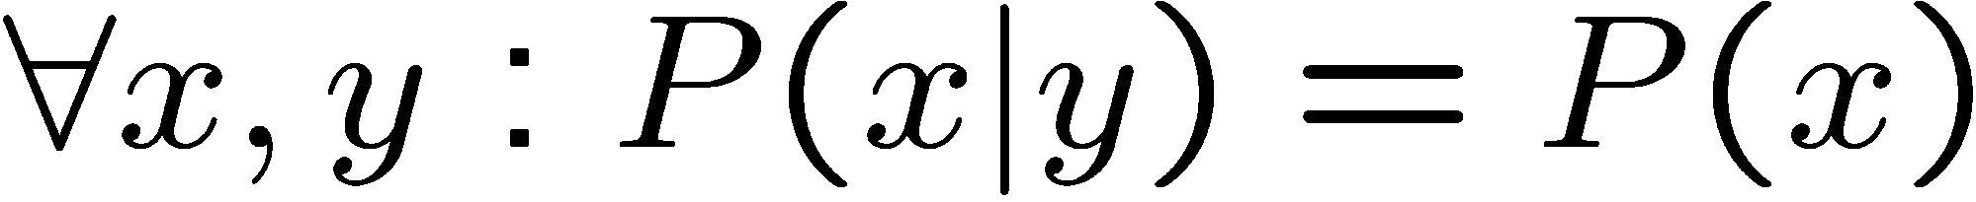
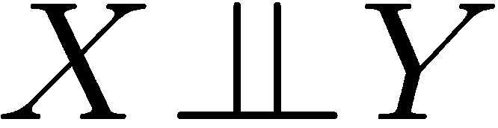
Independence
Two variables are independent if:
This says that their joint distribution factors into a product two simpler distributions
When random variables A and B are mutually independent or independent, it essentially means they don't influence each other's outcomes.
Another form:
We write:
Independence is a simplifying modeling assumption
It allows us to simplify calculations and make assumptions about how variables might (or might not) be related.
What could we assume for {Weather, Traffic, Cavity, Toothache}?
32

Slide 24
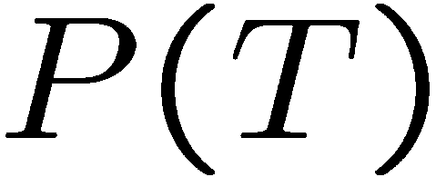
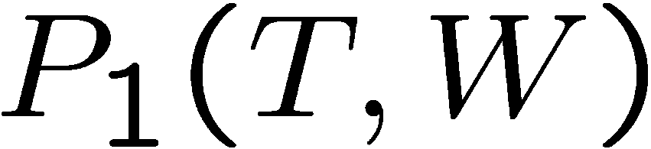
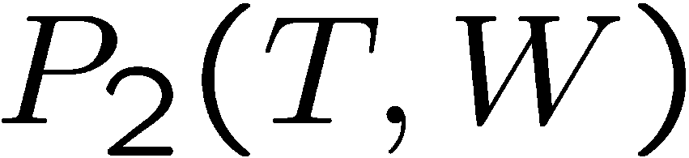
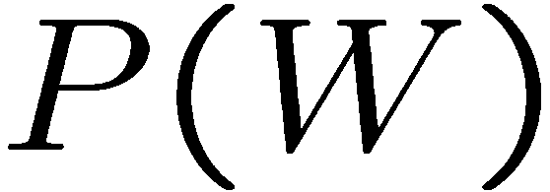
Example: Independence?
T | P
hot | 0.5
cold | 0.5
T | W | P
hot | sun | 0.4
hot | rain | 0.1
cold | sun | 0.2
cold | rain | 0.3
T | W | P
hot | sun | 0.3
hot | rain | 0.2
cold | sun | 0.3
cold | rain | 0.2
W | P
sun | 0.6
rain | 0.4

Slide 25
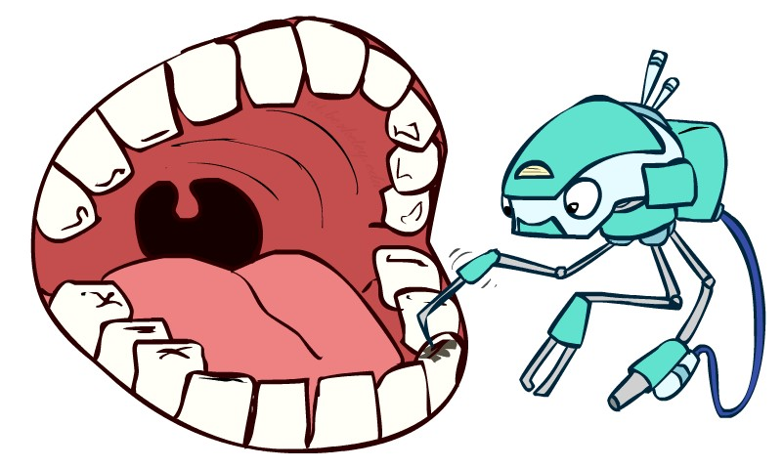
Conditional Independence
P(Toothache, Cavity, Catch)
If I have a cavity, the probability that the probe catches in it doesn't depend on whether I have a toothache:
  P(+catch | +toothache, +cavity) = P(+catch | +cavity)
The same independence holds if I don’t have a cavity:
  P(+catch | +toothache, -cavity) = P(+catch| -cavity)
Catch is conditionally independent of Toothache given Cavity:
  P(Catch | Toothache, Cavity) = P(Catch | Cavity)
Equivalent statements:
  P(Toothache | Catch , Cavity) = P(Toothache | Cavity)
  P(Toothache, Catch | Cavity) = P(Toothache | Cavity) P(Catch | Cavity)
  One can be derived from the other easily

Slide 26
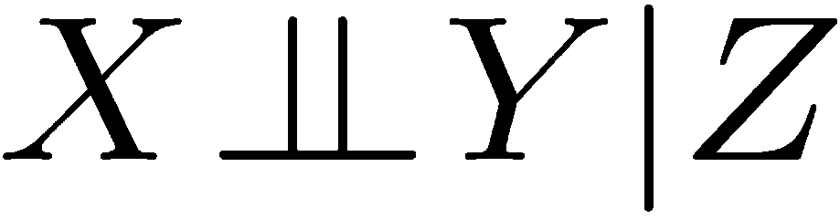
Conditional Independence
Unconditional (absolute) independence very rare (why?)
Conditional independence is our most basic and robust form of knowledge about uncertain environments.
X is conditionally independent of Y given Z if and only if:
or, equivalently, if and only if

Slide 27
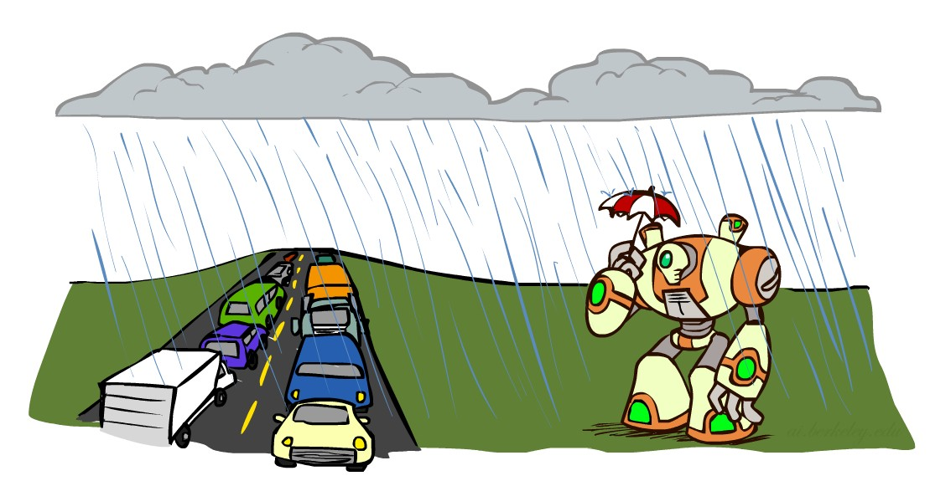
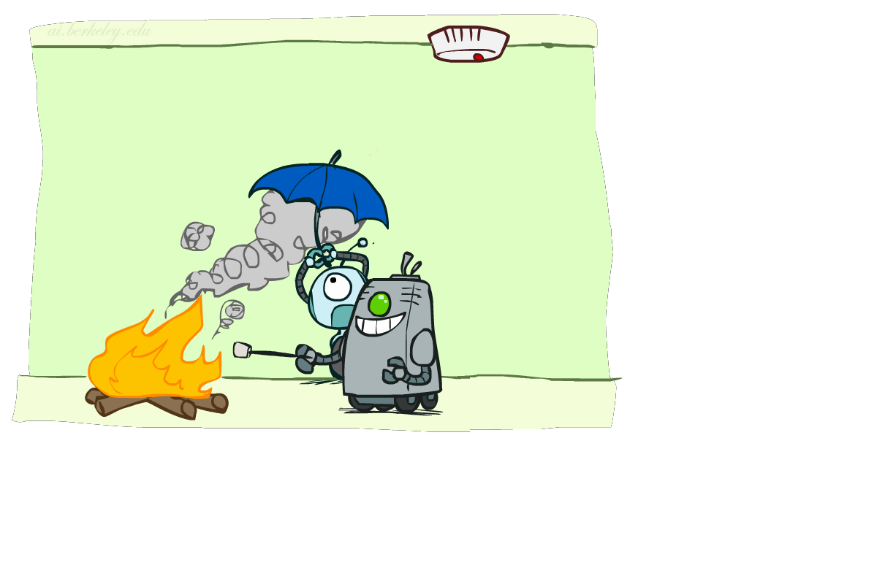
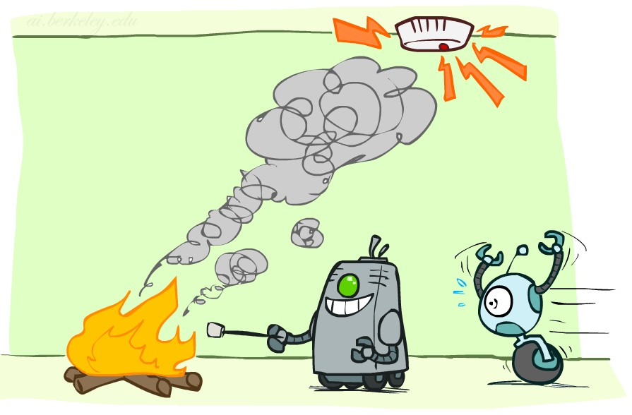
Conditional Independence
What about this domain:
  Traffic
  Umbrella
  Raining
What about this domain:
  Fire
  Smoke
  Alarm

Slide 28

Conditional Independence and the Chain Rule
Chain rule:
Trivial decomposition:
With assumption of conditional independence:
We can represent joint distributions by multiplying these simpler local distributions.
Bayes’nets / graphical models help us express conditional independence assumptions 42

Slide 29
Bayes’ Nets: Big Picture
Two problems with using full joint distribution tables
as our probabilistic models:
  With many variables, listing all possible combinations for the joint distribution becomes infeasible.
  Hard to learn (estimate) anything through empirical observation about more than a few variables at a time
Bayes’ nets: a technique for describing complex joint distributions (models) using simple, local distributions (conditional probabilities)
  More properly called graphical models
  We describe how variables locally interact
  Local interactions chain together to give global, indirect interactions

Slide 30
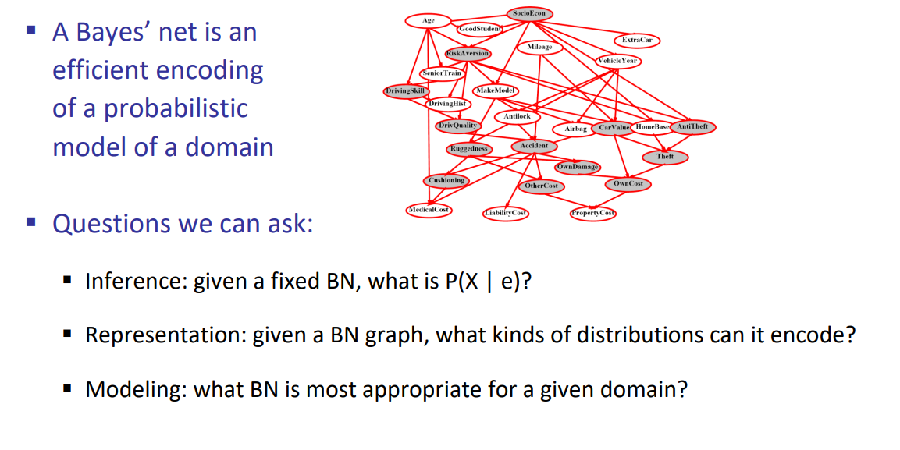
Example Bayes’ Net: Insurance

Slide 31
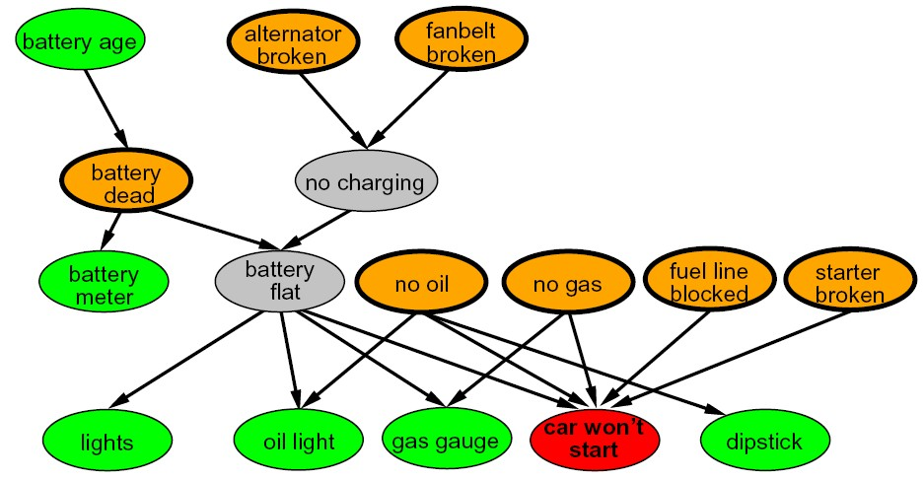
Example Bayes’ Net: Car

Slide 32
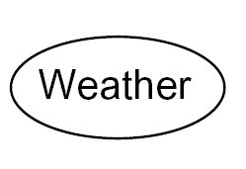
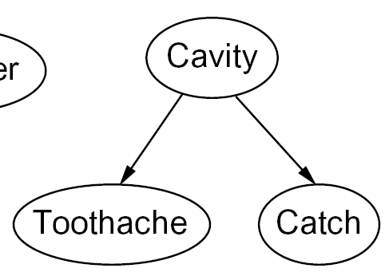
Graphical Model Notation
Nodes: variables (with domains)
  Can be assigned (observed) or unassigned (unobserved)
Arcs: interactions
  Indicate “direct influence” between variables
  Formally: encode conditional independence (more later)
For now: imagine that arrows mean
direct causation (in general, they don’t!)

Slide 33

Example: Coin Flips
N independent coin flips
X₁
X₂
X_{n}
No interactions between variables: absolute independence

Slide 34
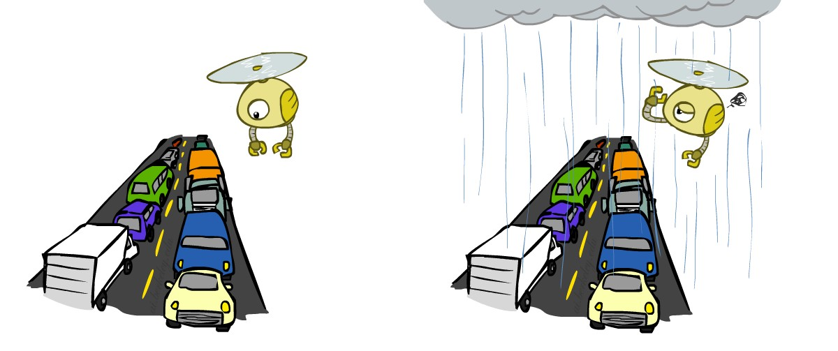
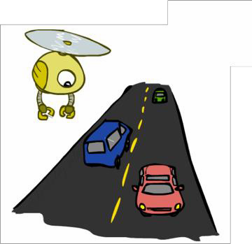
Example: Traffic
Variables:
  R: It rains
  T: There is traffic
Model 1: independence
Model 2: rain causes traffic
R
R
T
T
Why is an agent using model 2 better?
50

Slide 35
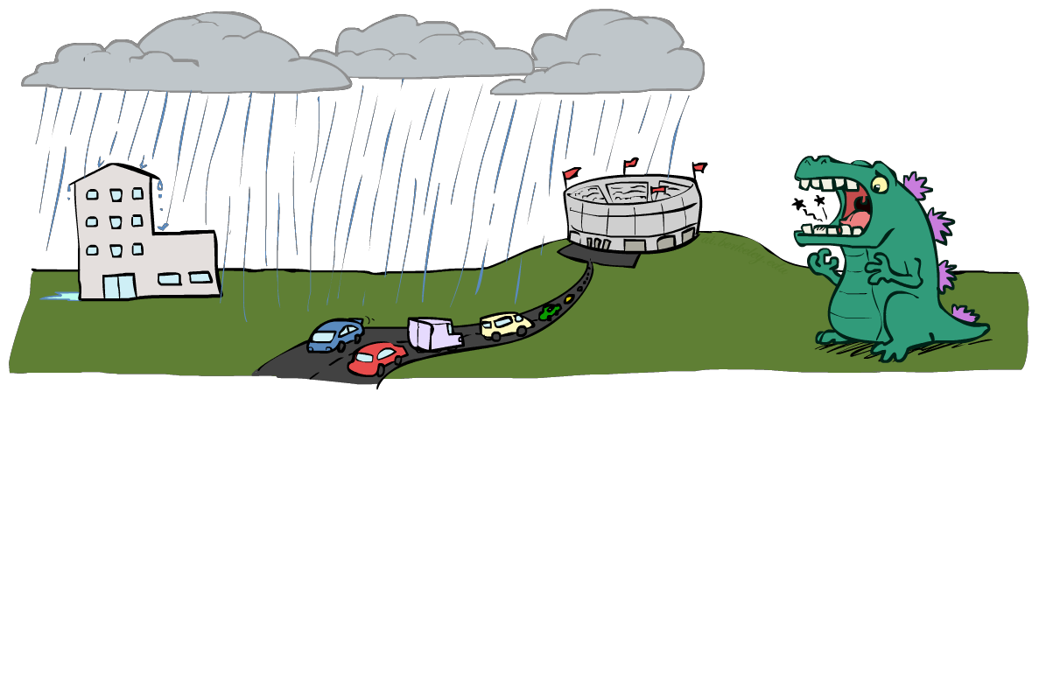
Example: Traffic II
Variables
  T: Traffic
  R: It rains
  L: Low pressure
  D: Roof drips
  B: Ballgame
  C: Cavity

Slide 36
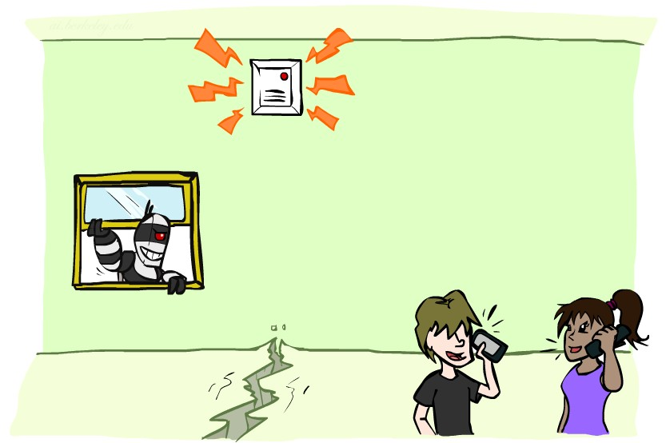
Example: Alarm Network
Variables
  B: Burglary
  A: Alarm goes off
  M: Mary calls
  J: John calls
  E: Earthquake!

Slide 37
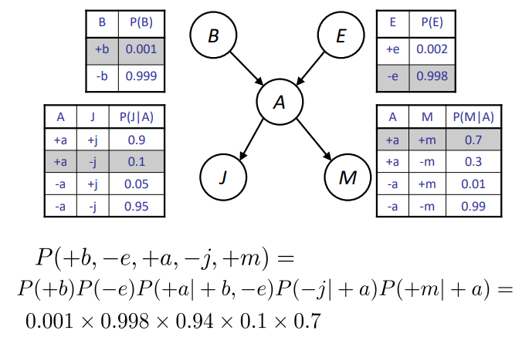
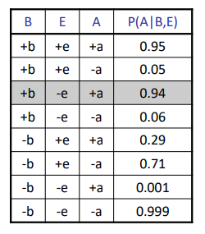
Example: Alarm Network
Variables
  B: Burglary
  A: Alarm goes off
  M: Mary calls
  J: John calls
  E: Earthquake!

Slide 38
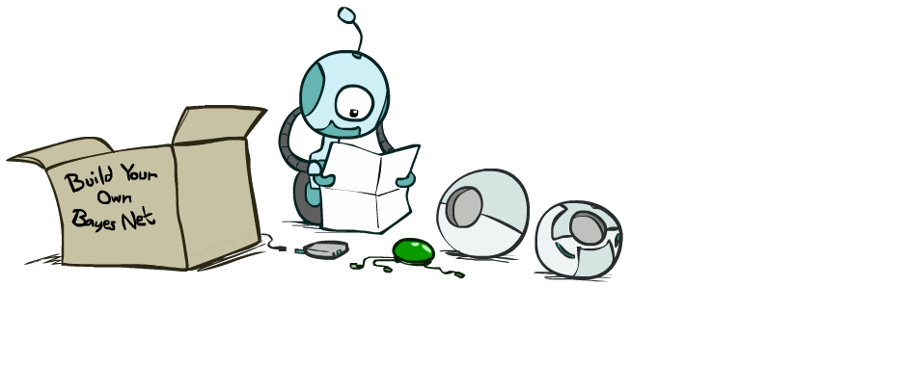
Bayes’ Net Semantics
55

Slide 39
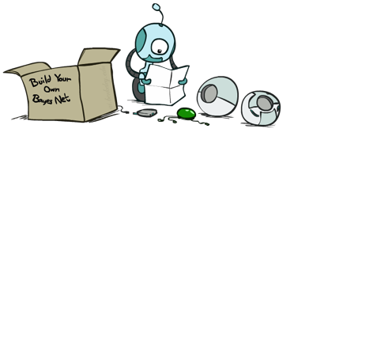


Bayes’ Net Semantics
A set of nodes, one per variable X
A directed, acyclic graph
A₁
A_{n}
A conditional distribution for each node
  A collection of distributions over X, one for each combination of parents’ values
X
CPT: conditional probability table
Description of a noisy “causal” process
A Bayes net = Topology (graph) + Local Conditional Probabilities
56

Slide 40


Probabilities in BNs
Bayes’ nets indirectly encode joint distributions
  As a product of local conditional distributions
  To see what probability a BN gives to a full assignment, multiply all the relevant conditionals together:
Example:
=P(-toothache|+cavity)P(+catch|+cavity)P(+cavity)
57

Slide 41


Bayes’ Net Representation
A directed, acyclic graph, one node per random variable
A conditional probability table (CPT) for each node
  A collection of distributions over X, one for each combination of parents’ values
Bayes’ nets implicitly encode joint distributions
A₁
A_{n}
As a product of local conditional distributions
To see what probability a BN gives to a full assignment,
multiply all the relevant conditionals together:
X
58

Slide 42
Example: Coin Flips
X₁
X₂
X_{n}
h | 0.5
t | 0.5
h | 0.5
t | 0.5
h | 0.5
t | 0.5
P(h)P(h)P(t)P(h)
Only distributions whose variables are absolutely independent can be represented by a Bayes’ net with no arcs.
60

Slide 43



Example: Traffic
R
+r | 1/4
-r | 3/4
P(+r)P(-t|+r) = ¼*1/4
+r
+t | 3/4
-t | 1/4
T
-r
+t | 1/2
-t | 1/2

Slide 44

Example: Alarm Network
B | P(B)
+b | 0.001
-b | 0.999
E | P(E)
+e | 0.002
-e | 0.998
Burglary
Earthqk
Alarm
B | E | A | P(A|B,E)
+b | +e | +a | 0.95
+b | +e | -a | 0.05
+b | -e | +a | 0.94
+b | -e | -a | 0.06
-b | +e | +a | 0.29
-b | +e | -a | 0.71
-b | -e | +a | 0.001
-b | -e | -a | 0.999
John calls
Mary calls
A | J | P(J|A)
+a | +j | 0.9
+a | -j | 0.1
-a | +j | 0.05
-a | -j | 0.95
A | M | P(M|A)
+a | +m | 0.7
+a | -m | 0.3
-a | +m | 0.01
-a | -m | 0.99
P(M|A)P(J|A)
P(A|B,E)

Slide 45
Example: Traffic
Causal direction
Causality refers to a cause-and-effect relationship between two events or variables. One event (the cause) directly influences the occurrence or outcome of another event (the effect).
Low pressure causes rain causes traffic, high pressure causes no rain causes no traffic
R
+r | 1/4
-r | 3/4
+r | +t | 3/16
+r | -t | 1/16
-r | +t | 6/16
-r | -t | 6/16
+r | +t | 3/4
 | -t | 1/4
T
-r | +t | 1/2
 | -t | 1/2

Slide 46


Example: Reverse Traffic
Reverse causality?
T
+t | 9/16
-t | 7/16
+r | +t | 3/16
+r | -t | 1/16
-r | +t | 6/16
-r | -t | 6/16
+t | +r | 1/3
 | -r | 2/3
R
-t | +r | 1/7
 | -r | 6/7

Slide 47

Causality?
When Bayes’ nets reflect the true causal patterns:
  Often simpler (nodes have fewer parents)
  Often easier to think about
  Often easier to elicit from experts
BNs need not actually be causal
  Sometimes no causal net exists over the domain (especially if variables are missing)
  E.g. consider the variables Traffic and Drips
  End up with arrows that reflect correlation, not causation
What do the arrows really mean?
  Topology may happen to encode causal structure
  Topology really encodes conditional independence

Slide 48




Bayes’ Rule
Two ways to factor a joint distribution over two variables:
That’s my rule!
Dividing, we get:
Why is this at all helpful?
  Lets us build one conditional from its reverse
  Often one conditional is tricky but the other one is simple
  Foundation of many systems we’ll see later (e.g. ASR, MT)
In the running for most important AI equation!
67

Slide 49

Inference with Bayes’ Rule
Example: Diagnostic probability from causal probability:
Example:
  M: meningitis, S: stiff neck
Example
givens
Note: posterior probability of meningitis still very small
Note: you should still get stiff necks checked out! Why?
68

Slide 50
Quiz: Bayes’ Rule
Given:
D | W | P
wet | sun | 0.1
dry | sun | 0.9
wet | rain | 0.7
dry | rain | 0.3
R | P
sun | 0.8
rain | 0.2
What is P(W | dry) ?

Slide 51
Quiz: Bayes’ Rule
Given:
D | W | P
wet | sun | 0.1
dry | sun | 0.9
wet | rain | 0.7
dry | rain | 0.3
R | P
sun | 0.8
rain | 0.2
What is P(W | dry) ?
P(sun|dry) ~ P(dry|sun)P(sun) = .9*.8 = .72 P(rain|dry) ~ P(dry|rain)P(rain) = .3*.2 = .06 P(sun|dry)=12/13
P(rain|dry)=1/13

Slide 52

Uncertainty Summary
BN lecture

Slide 53


Bayes’ Net Representation
A directed, acyclic graph, one node per random variable
A conditional probability table (CPT) for each node
  A collection of distributions over X, one for each combination of parents’ values
Bayes’ nets implicitly encode joint distributions
  As a product of local conditional distributions
  To see what probability a BN gives to a full assignment,
multiply all the relevant conditionals together:

